Slide 2
Regions of the Czech Republic
Presentation by Tereza Feixová
for

Slide 3
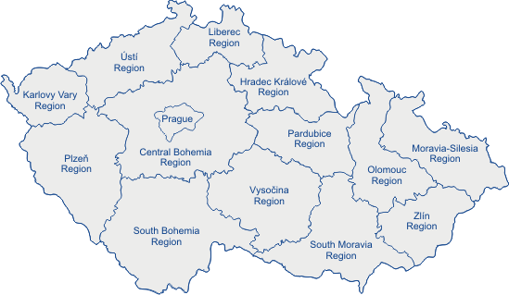
14 regions (including Prague)
Pilsen
Sušice

Slide 4
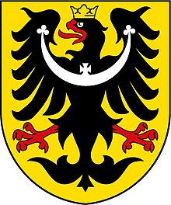
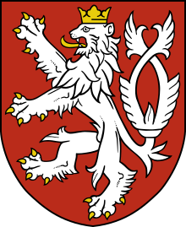
3 historical territories
Bohemia
Silesia
Prague
Pilsen
Moravia
Brno

Slide 5
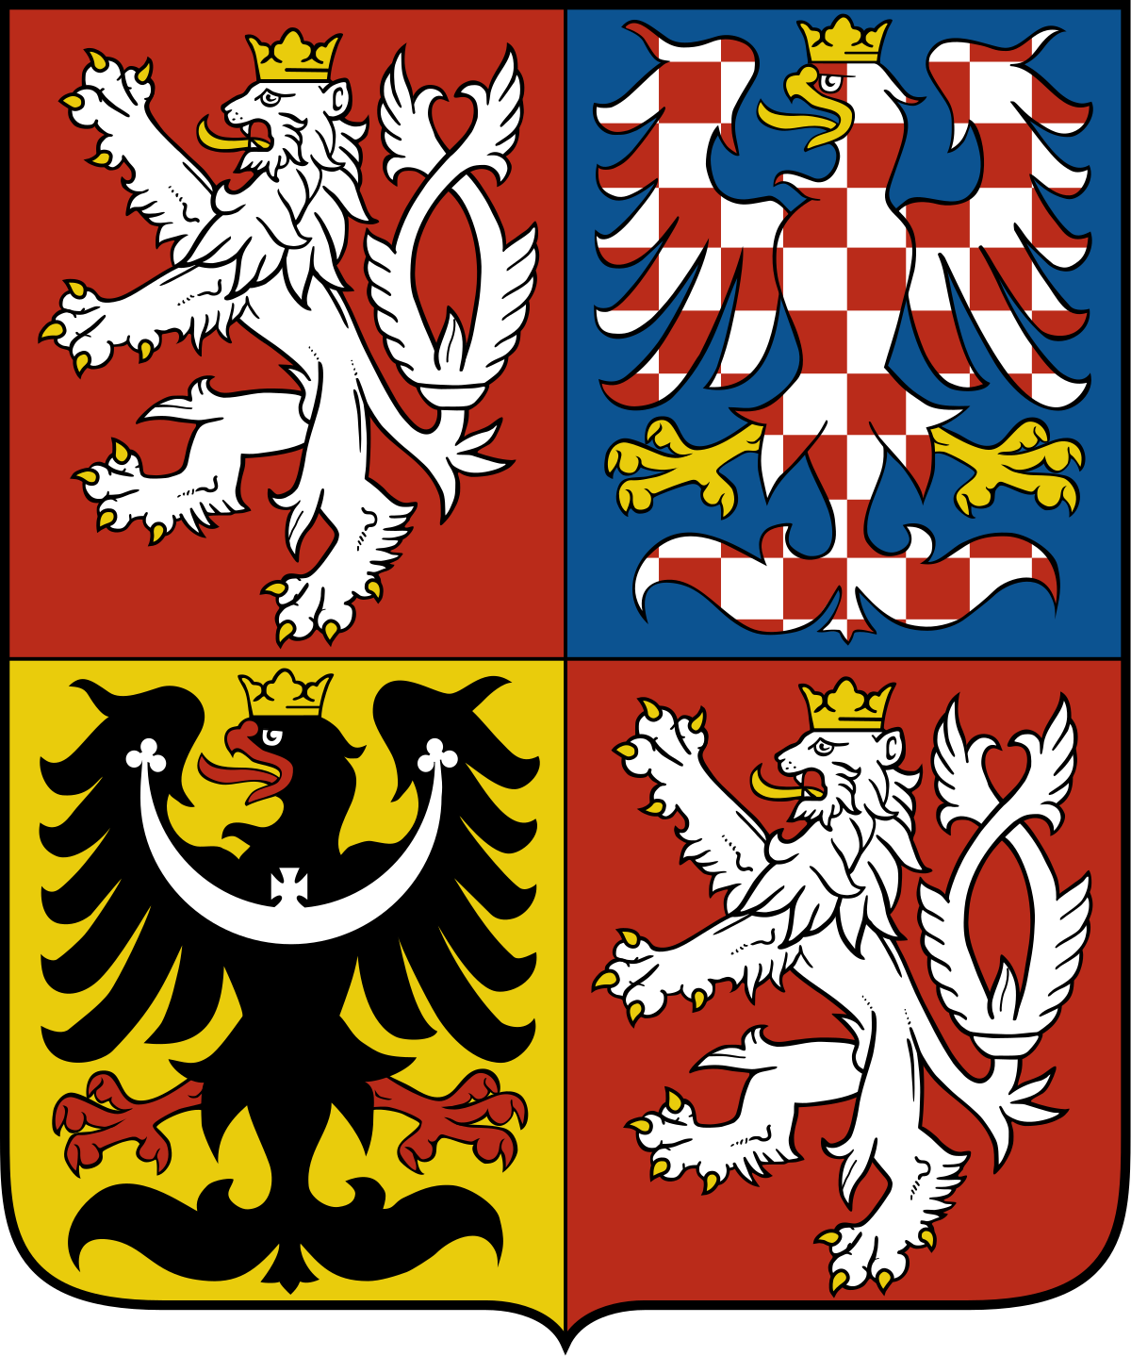
The Czech Lion
The Moravian eagle
The Silesian Eagle
The Czech Lion

Slide 6
Bohemia, Moravia, Silesia Prague X Brno the Pilsen Region Slovakia
Bohemia
Silesia
Prague
Pilsen
Moravia
Brno
Slovakia

Slide 7
the Pilsner region
________
tuto,čekuláda…
,,
Pilsner Urquell
,,
national park ŠUMAVA

Slide 8
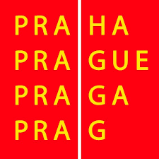
___
Prague
Praguers
Culture, architecture, history, theatre…
terrible traffic

Slide 9
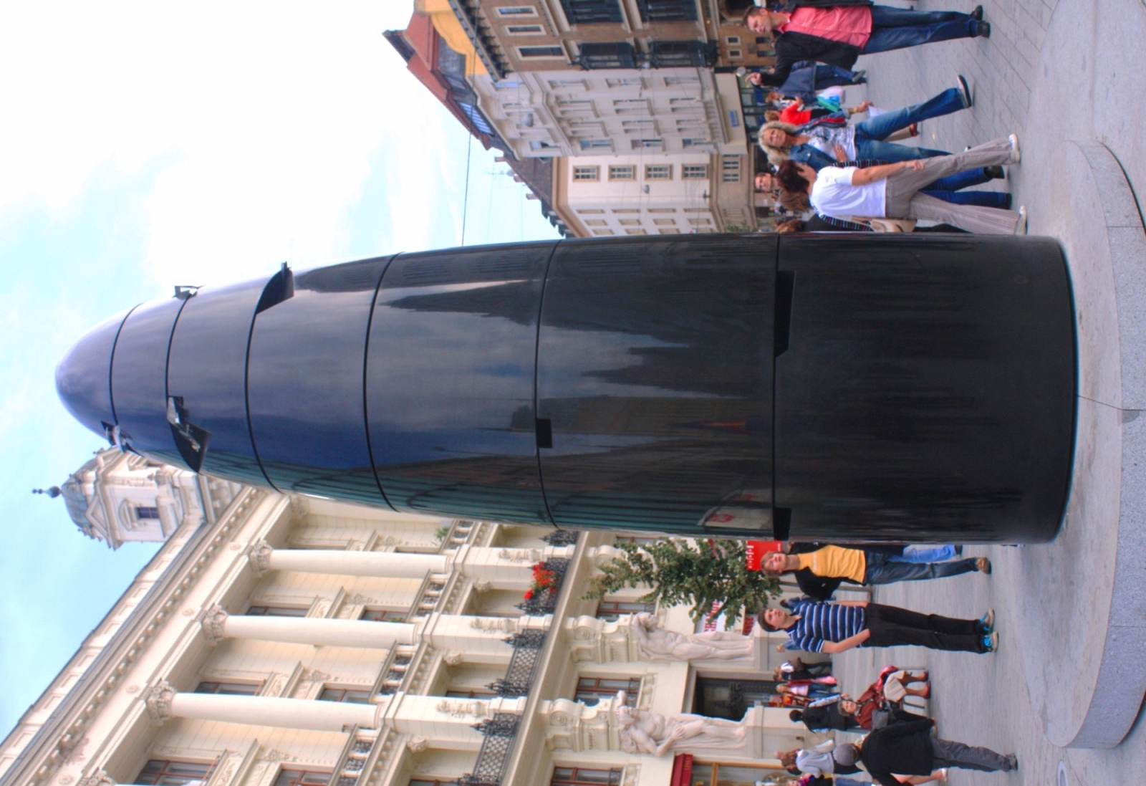
Brno
__
Overall pretty chill,
Little competitive with

Slide 10
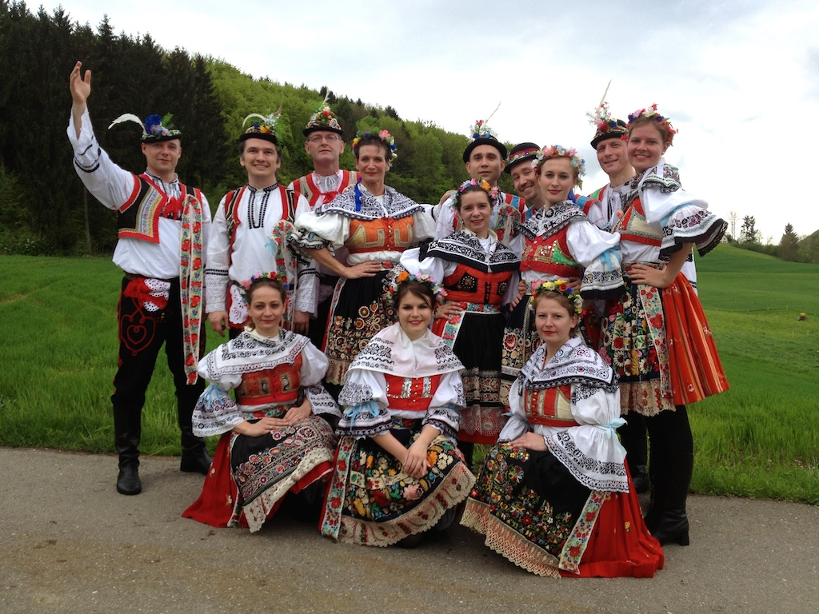
Moravia
____
Wine, tradition
Moravians

Slide 11
Silesia
___
Mountains
,,discount Poland“

Slide 12
Slovakia
____
Do not have underground/subway
Butt of most czech jokes
,,discount Ukraine“

Slide 13
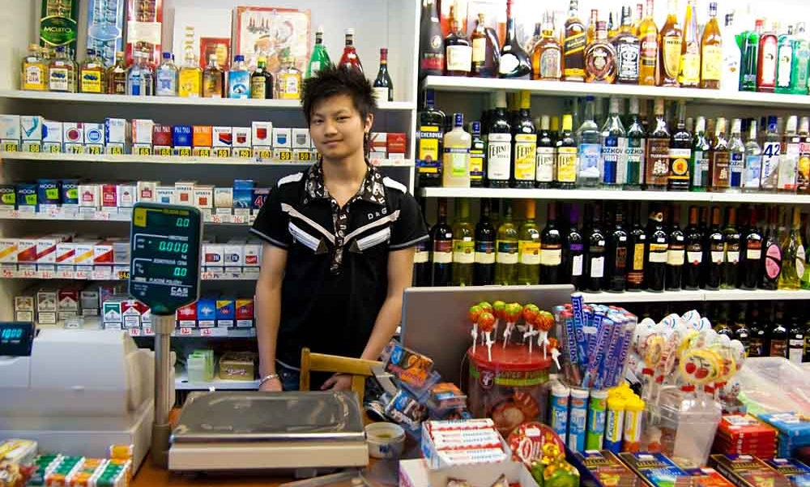
Races, ethnicities & immigrants in CR
______________

Slide 14
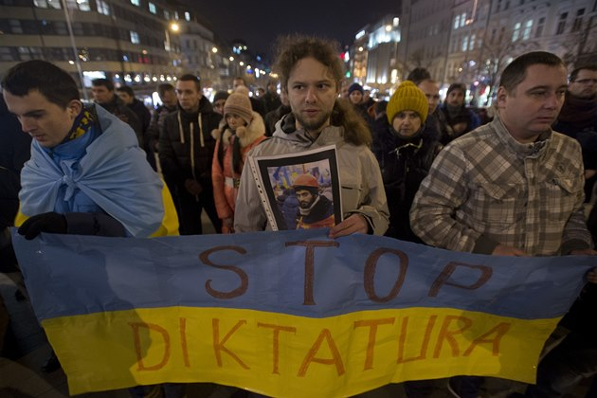
Races, ethnicities & immigrants in CR
______________

Slide 15
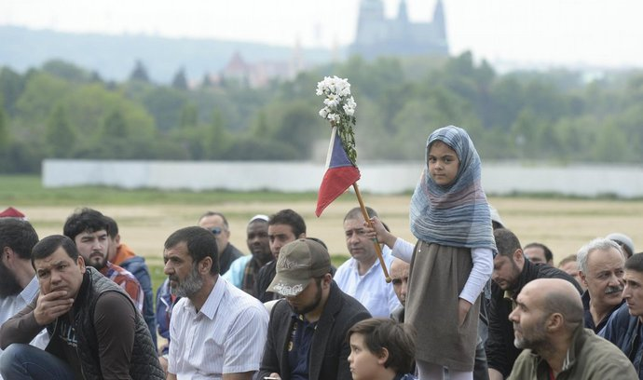
Races, ethnicities & immigrants in CR
______________

Slide 16
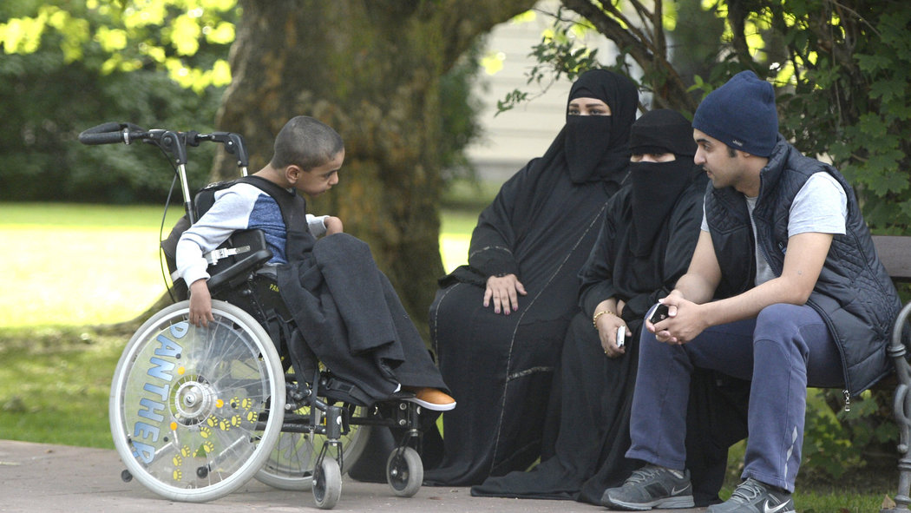
Races, ethnicities & immigrants in CR
______________

Slide 17
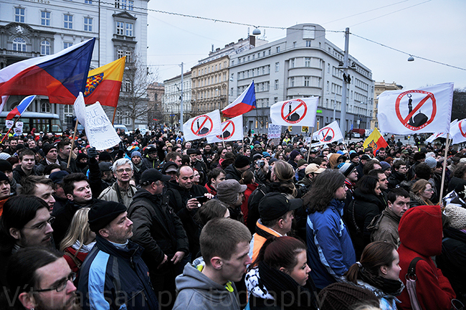
Races, ethnicities & immigrants in CR
______________

Slide 18
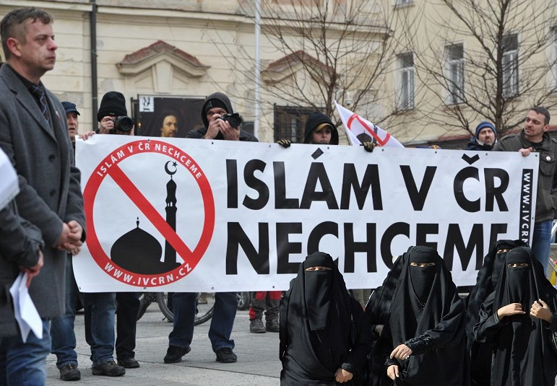
Races, ethnicities & immigrants in CR
______________

Slide 19
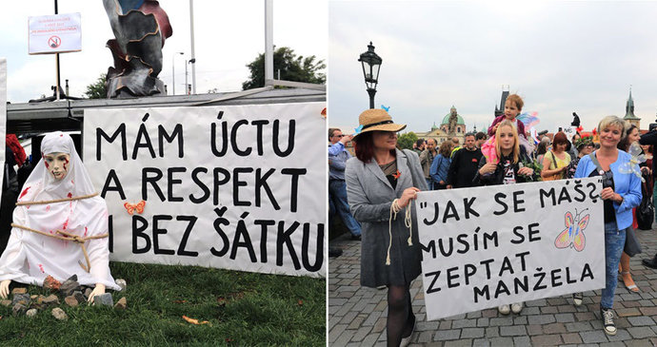
Races, ethnicities & immigrants in CR
______________

Slide 20
Races, ethnicities & immigrants in CR
______________

Slide 21
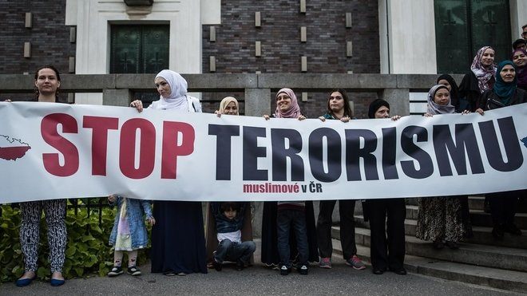
Races, ethnicities & immigrants in CR
______________

Slide 22
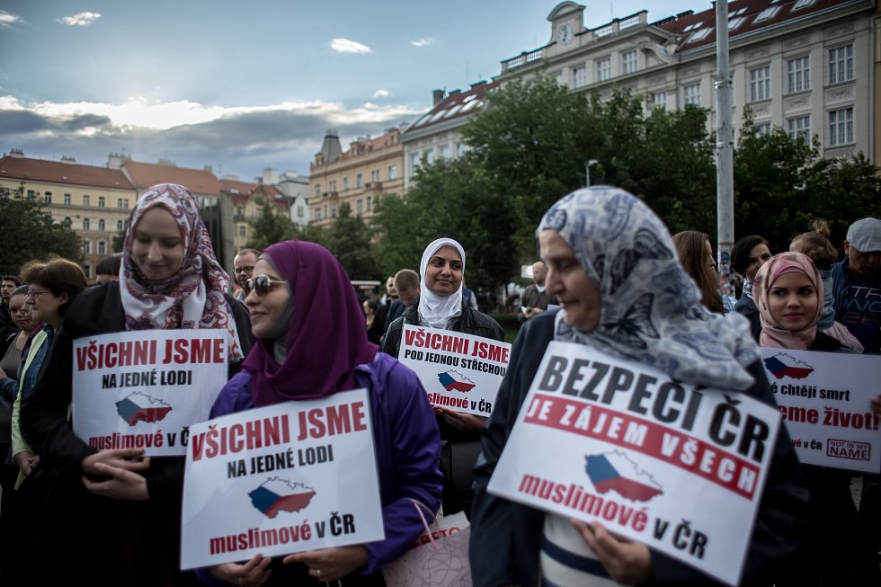
Races, ethnicities & immigrants in CR
______________

Slide 23
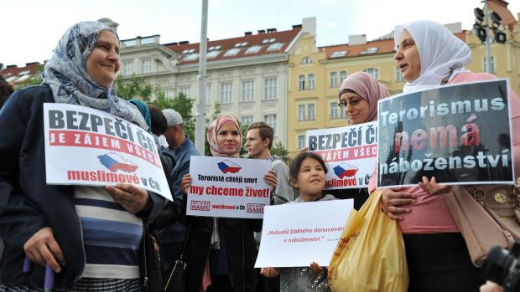
Races, ethnicities & immigrants in CR
______________

Slide 24
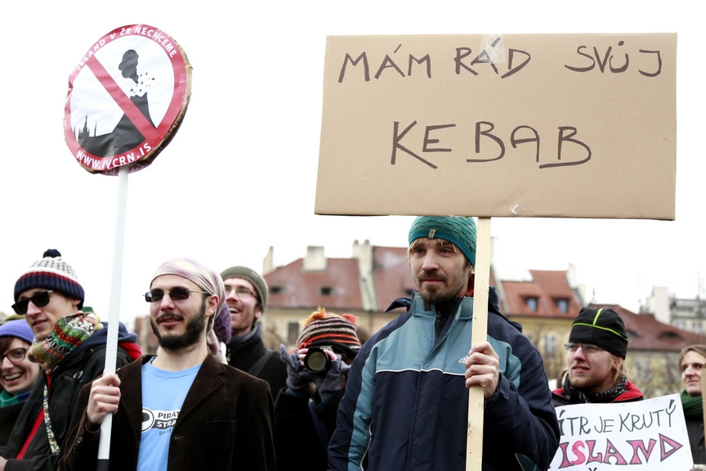
Races, ethnicities & immigrants in CR
______________

Slide 25
Thank you for your time and attention, hope you liked the presentation ☺

